Slide 1

US Real Estate 2015 - 2022

Slide 2

Group Members
Chandrani Ghosh
Francis Rivera
Simpel Osman
Wei Chen

Slide 3
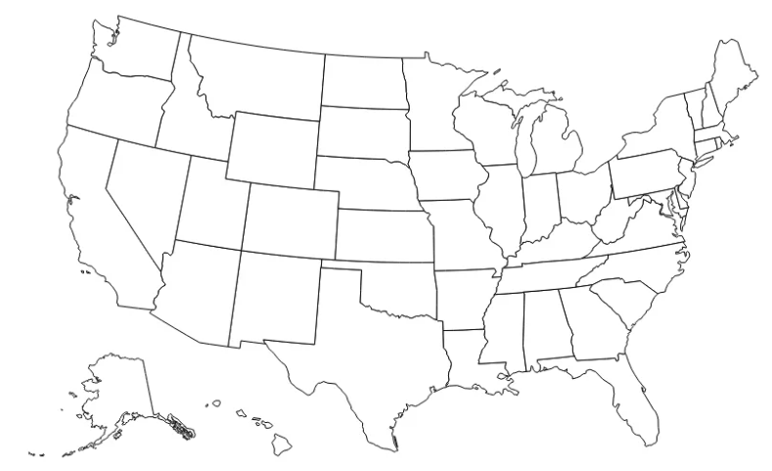

Cities WE have Focused
Seattle
San Jose
Phoenix
Tampa
Austin

Slide 4
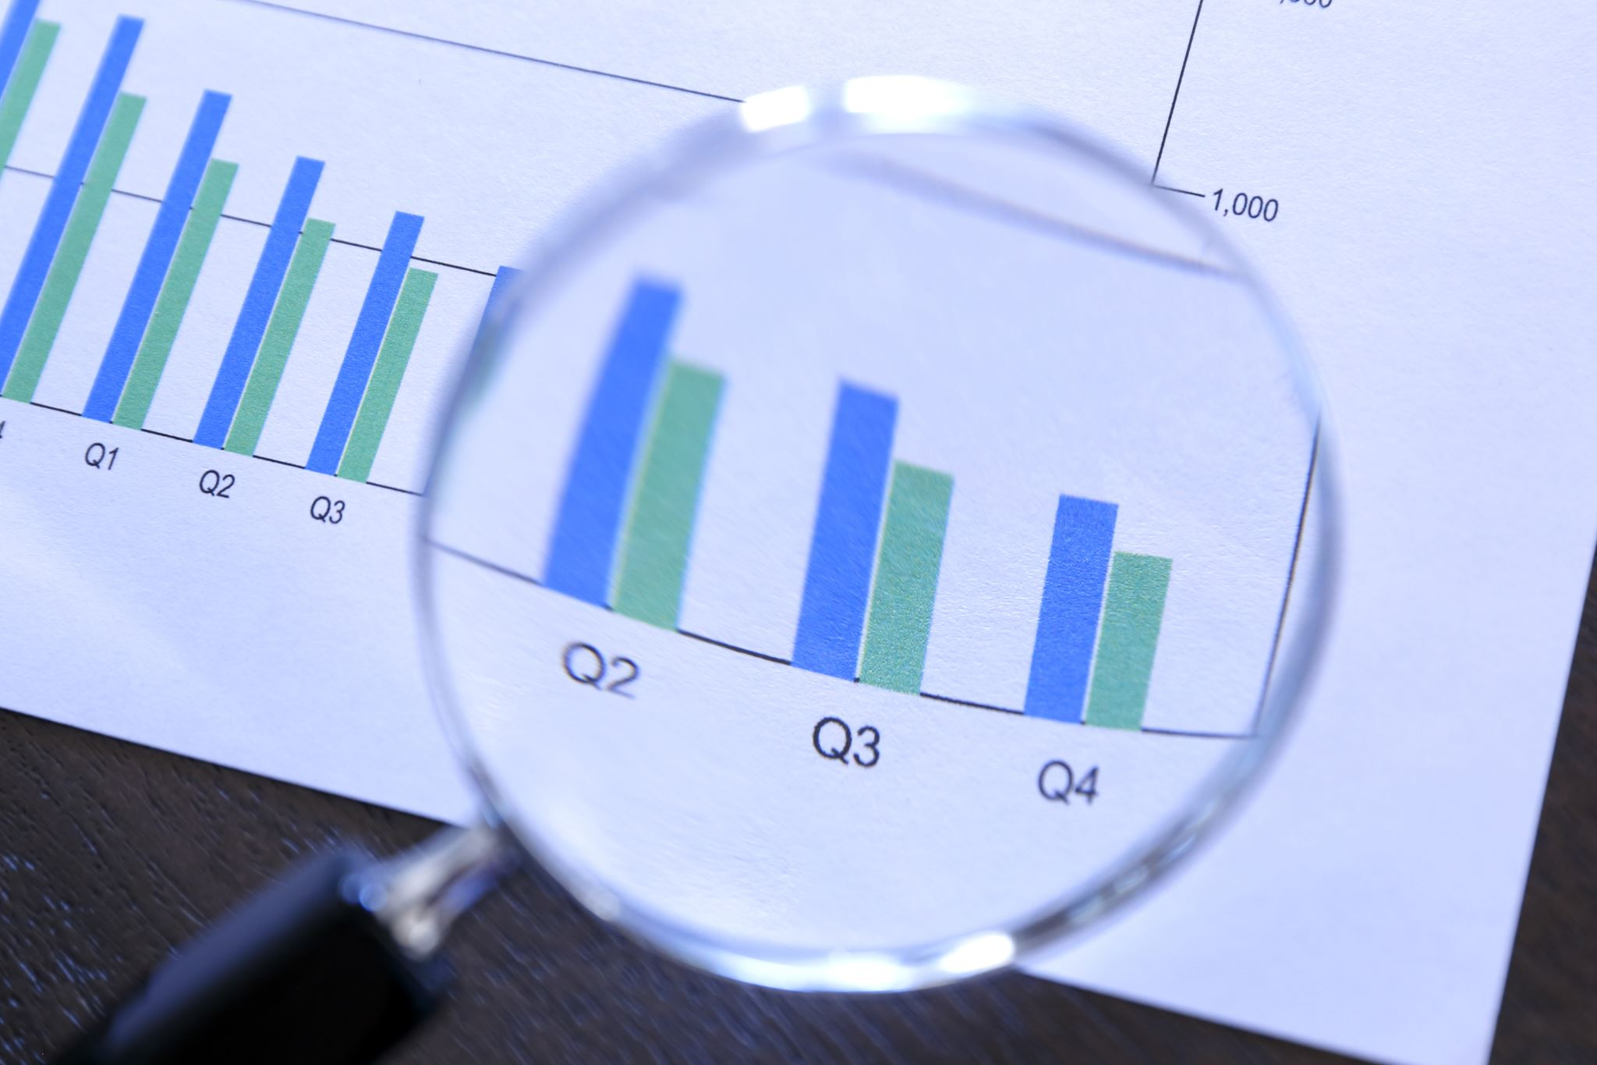
Our Focus
1 Seasonal changes and Effects
2 The impacts of Pandemic on Real Estate
3 Finding cities with better investment potential

Slide 5

Real estate is an important aspect of everybody’s life as we all need a place to stay. We have been hearing about the housing bubble over the last few years and burst that is looming. We want to use our data to see whether this is true or not.
During the year of 2015, homes had a more reasonable price to be purchased.
When pandemic hits in 2020, a world crisis affected globally the economy and interest rates on homes dropped. A few homeowners were able to finance their homes, a few weren’t. After two years, an inflation developed, and homes became more expensive to a lot of people. Either it was too expensive to buy or keep.
Cash flow is important due to the inflation developed. Real-estate is a passive income; we are wondering which states are the best places to consider investing in near future. Rising property values, affordable prices etc. are the key metrics we will consider.

Slide 6
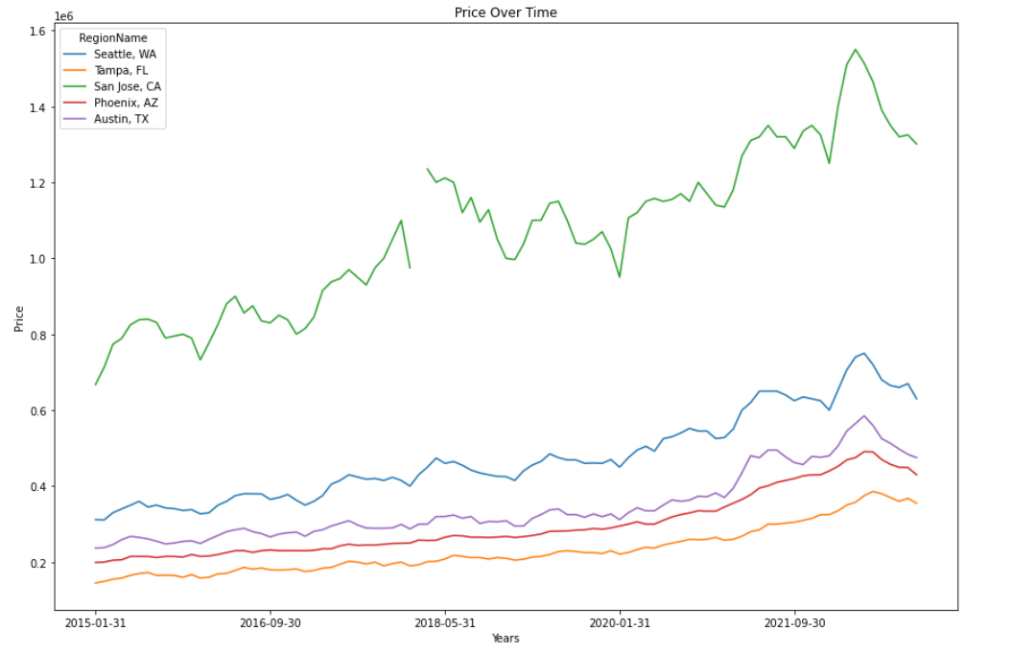

Slide 7
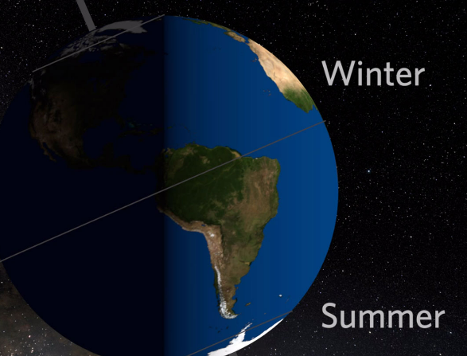
1
Seasonal changes and Effects

Slide 8
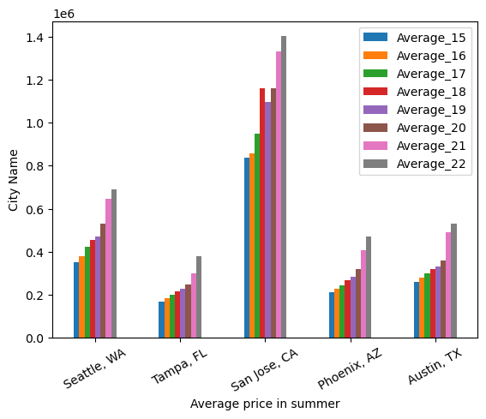
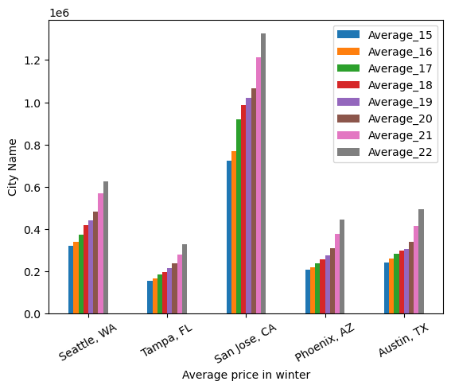
SUMMER VS WINTER

Slide 9

Paired T-Test
H₀ = The seasons have no effect on the sale prices of the houses
H₁ = The seasons effect the sale prices of the houses
pvalue = 2.02297199090102e-08

Slide 10

2
The impacts of Pandemic on Real Estate

Slide 11
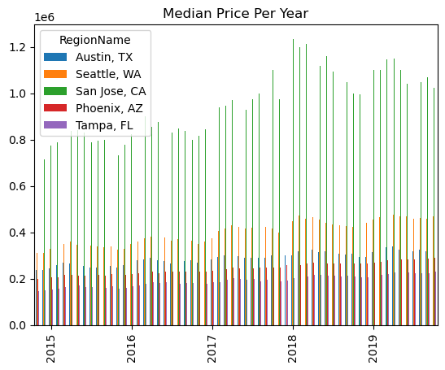
Pre-Pandemic Effects

Slide 12
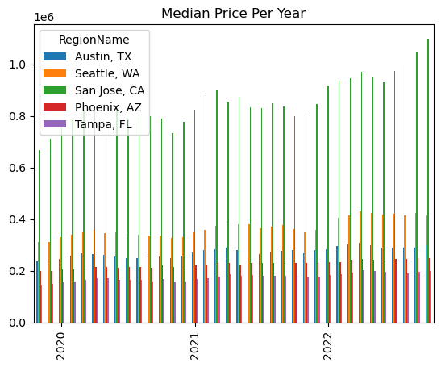
Post-Pandemic Effects

Slide 13

3
Finding cities with better investment potential

Slide 14
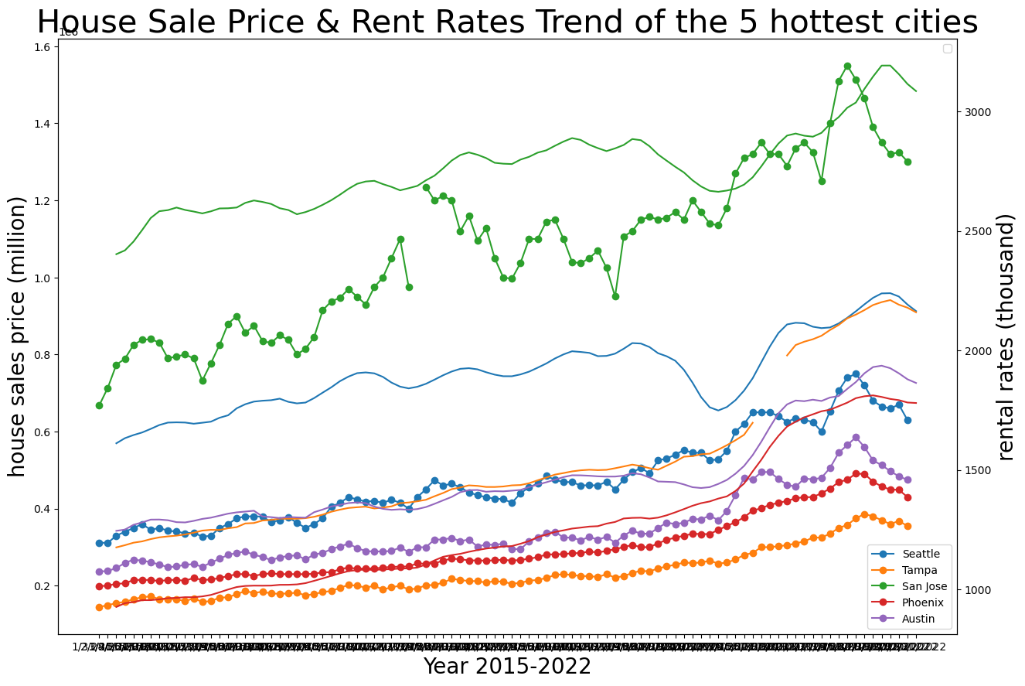

Slide 15
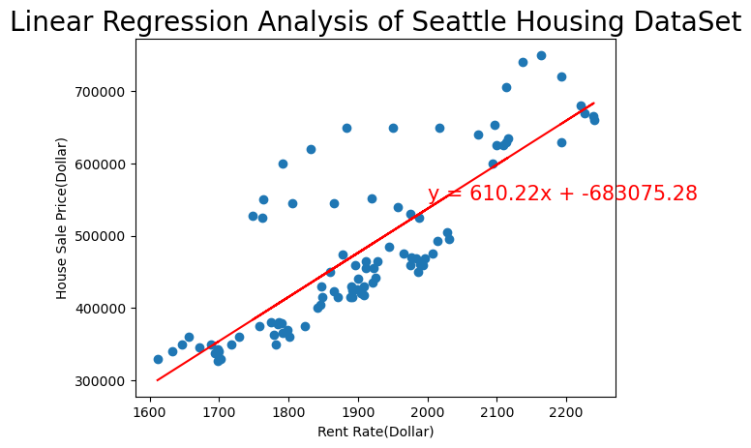

Slide 16

Challenges
Good datasets
Missing data
Time

Slide 17

Conclusion
The Pandemic in the real estate market caused the listing prices of homes especially in certain areas to rise from previous years.
The crisis in the real estate market caused the listing prices of homes in certain areas to fall...
We have seen an more increase in 5 hottest cities because of people moving more to certain areas and pay less taxes however many companies have moved to Austin Texas and made a big increase in the price.

